Slide 1
Application of Machine Learning to Achieve Robust and Accurate Classification of Well Log Data
ACSE-9
10th, SEP, 2019
MASTER INDEPENDENT RESEARCH PROJECT
Runzhi Zhou

Slide 2
Acknowledgments
With many thanks to my supervisors, Dr. Gerard Gorman, Dr. Navjot Kukreja,
and Dr. Peter Fitch, for their extensive support and guidance throughout this project.
Runzhi Zhou

Slide 3
Introduction
Dataset
Limitations
Runzhi Zhou

Slide 4
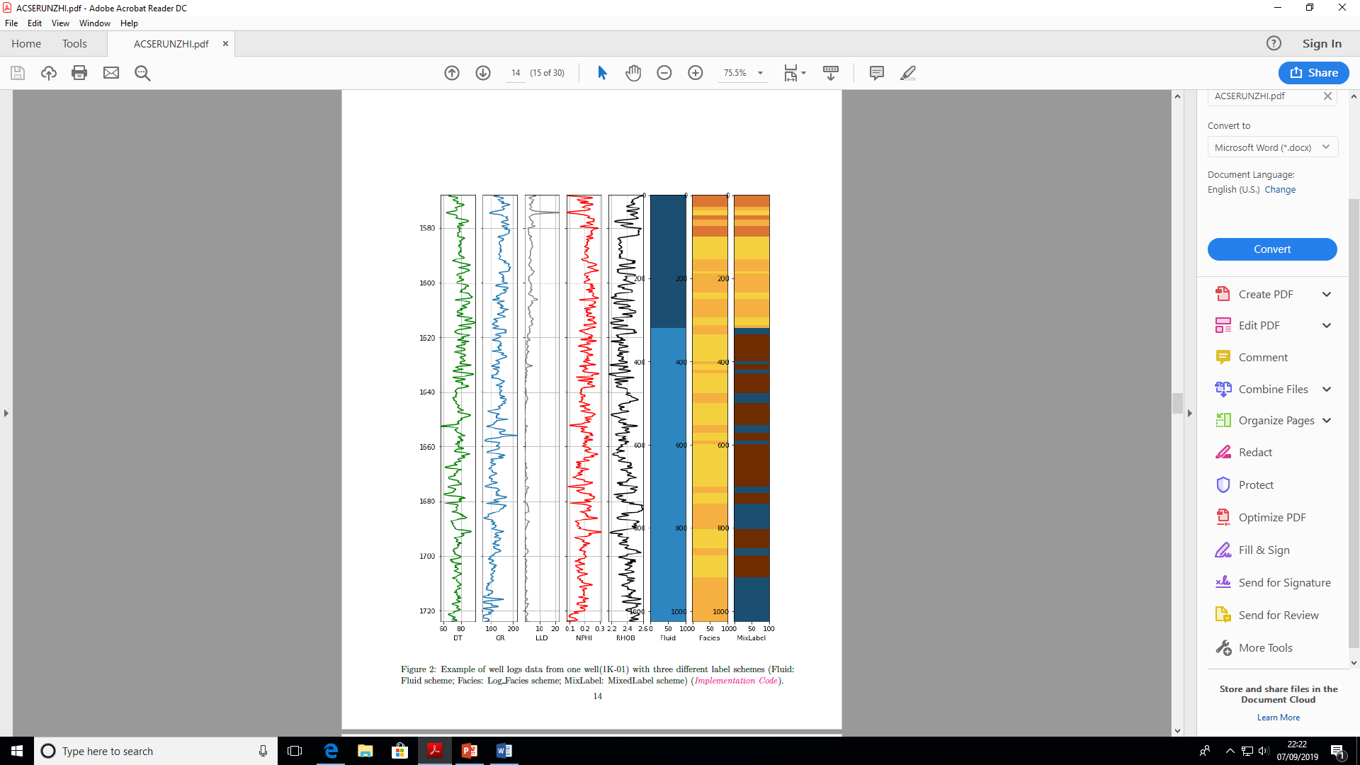
Introduction
Well log:
(a form of geoscience recording data)
Labels
Runzhi Zhou

Slide 5
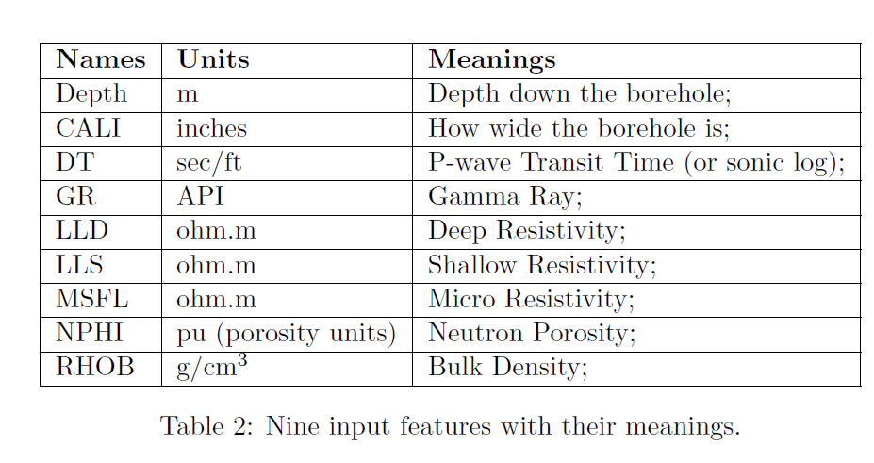
Introduction (Input Features)
9 input features
Runzhi Zhou

Slide 6
Introduction (Input Features)
6 common input features
Runzhi Zhou

Slide 7

Introduction (Label Schemes)
Focus more on Log_Facies
Fluid is too easy to be classified
MixedLabel (5 classes)
To check whether it could have
good performance or not.
Runzhi Zhou

Slide 8
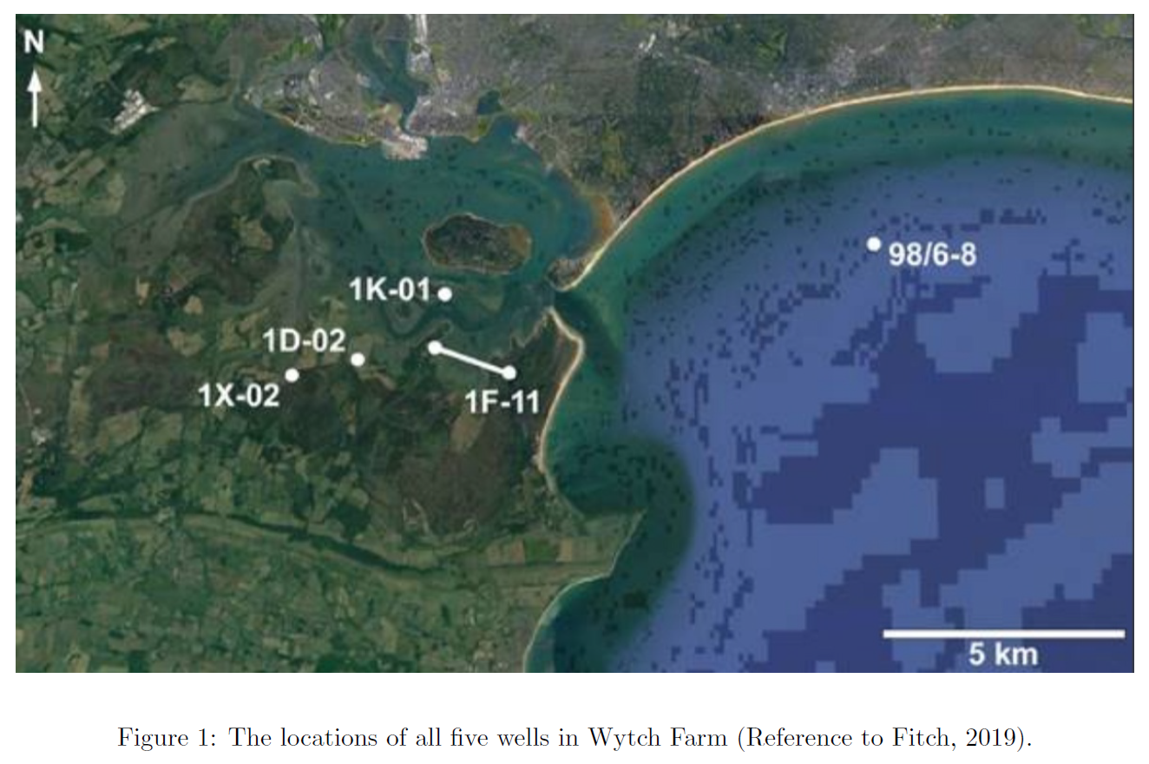
Introduction (wells locations)
Runzhi Zhou

Slide 9
Introduction (Limitations)
Five labelled wells with total 4695 data points.
Different geologists might come up with different labelling schemes on well log data.
Input features are different for different dataset.
Cannot apply the same hyperparameters.
Cannot simply compare the accuracy across data sets !
Find standard workflow with basic machine learning methods.
Find solution for companies with limited training data.
Runzhi Zhou

Slide 10
ACSE-9
1. Supervised learning
Approach and evaluation
(1) Inputs Features Selection
(Logistic Regression)
(2) Training and Testing
(Logistic Regression)
(3) Our Proposed Data Augmentation Method
(Logistic Regression & Support Vector Machines)
(4) Setting Threshold Prediction Rate
(Logistic Regression)
2. Unsupervised Learning
Approaches and Evaluation
Qualitative Evaluation by PCA and t-SNE
Quantitative Evaluation with K-means Clustering
Runzhi Zhou
Notes:
Since I have tried so many tests, I will present it really quick, please feel free to ask me any question if I didn’t explain them clear.

Slide 11
1. Supervised learning
Inputs Features Selection
Training and Testing
Our Proposed Data Augmentation Method
Setting Threshold Prediction Rate
Runzhi Zhou
Notes:
I have four main topics.

Slide 12
1. Supervised learning
Inputs Features Selection (Logistic Regression)
Should we include all the input features?
Should we include Depth?
Runzhi Zhou

Slide 13
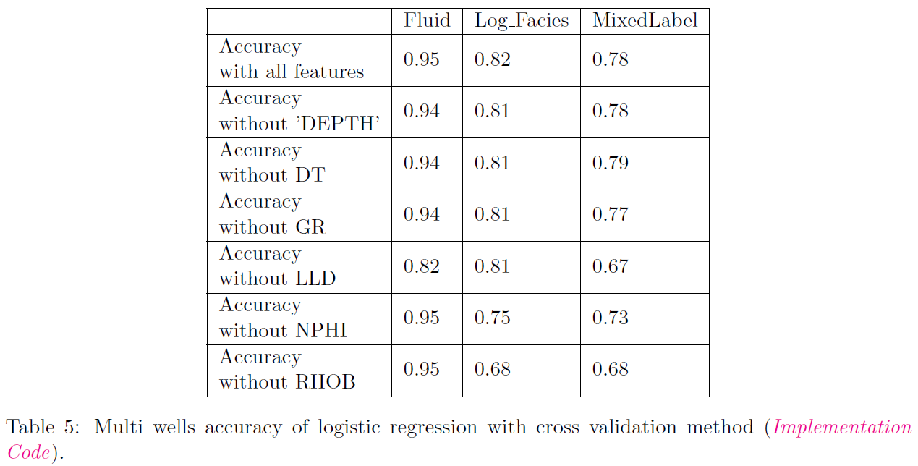
1. Supervised learning Approach and evaluation
(1) Inputs Features Selection (Control Variables)
(Multi- wells)
(All Labels)
Runzhi Zhou
Notes:
1: The accuracy is the highest when we include all the inputs features.
2: For the fluid label, the missing of LLD decrease the accuracy dramatically,
3: same for Log_facies, the missing of NPHI and LLD will decease the accuracy dramatically.
4: For Mixedlabel, because it is mixed by the Fluid and Log_facies, LLd, NPHI and RHOB all influence its accuracy.
5: noticeably, The accuracy of MixedLabel are around the same as the log_facies

Slide 14
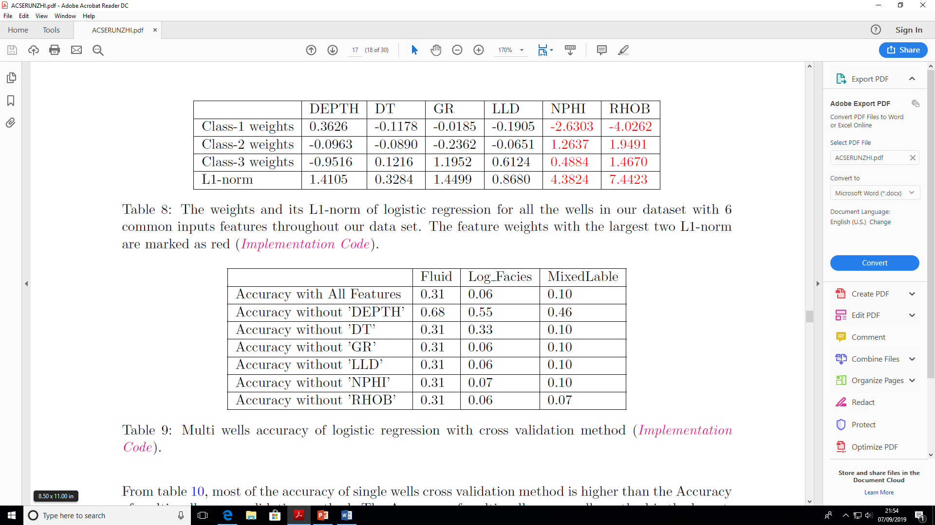
1. Supervised learning Approach and evaluation
(1) Inputs Features Selection (Weights)
(Multi- wells)
(Log_Facies)
Runzhi Zhou
Notes:
Then, I print out the weight for each input features and make a comparasion.
Logistic regression is monotonically increasing, the absolute values of weights determine the importance of features.
The weights for NPHI and RHOB are high
I did the same test for the single well again, the result is really different.

Slide 15
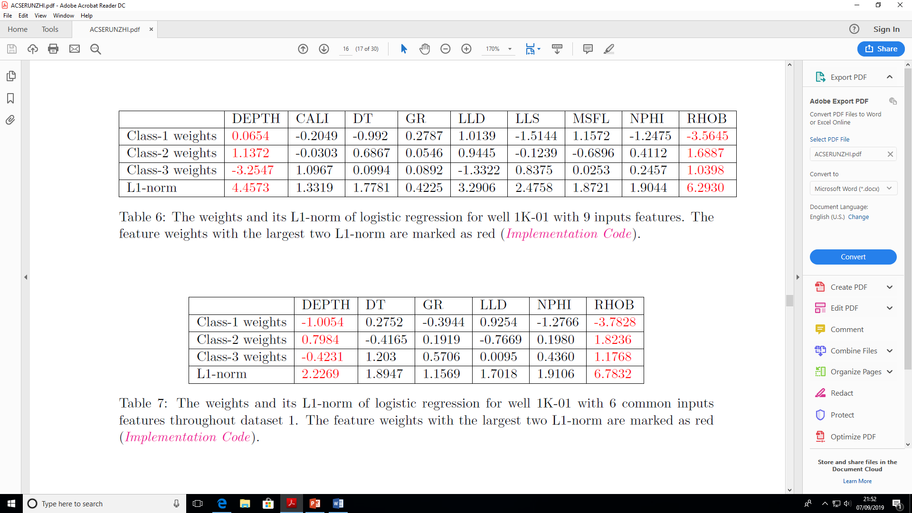
1. Supervised learning Approach and evaluation
(1) Inputs Features Selection (Weights)
(Single- well)
(Log_Facies)
Runzhi Zhou
Notes:
The weights for depth are really high.
It means that the depth is the main feature for labeling when we have limited training data.
I came up with a question, is Depth really important?

Slide 16
1. Supervised learning Approach and evaluation
(1) Inputs Features Selection (Control Variables)
(one well for training
one well for testing)
(Log_Facies)
WHY? --- limited training data --- Depth is dominating
Runzhi Zhou
Notes:
So then, I use one well as training data and another well as testing data, to do the control variable test again. SUPRESINGLY,
When we exclude the depth, the accuracy is the highest.
The model is Really not robust
WHY????

Slide 17
1. Supervised learning Approach and evaluation
(1) Inputs Features Selection (Control Variables)
Highest accuracy
(Multi- wells)
(All Labels)
More Robust
Depth is no longer dominating
Runzhi Zhou
Notes:
When we have more data, including depth can increase the testing accuracy as well.
Because the depth feature is no longer dominating here, and we can get a robust model with including all the input features.

Slide 18
1. Supervised learning
(2) Training and Testing (Logistic regression)
What data splitting method should we use?
Runzhi Zhou
Notes:
From the articles I have read, there are mainly 3 data splitting methods.

Slide 19
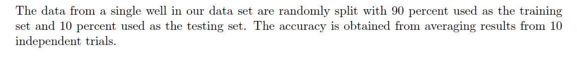
1. Supervised learning Approach and evaluation
(2) Training and Testing
(1: Single well – Cross-validation)
Runzhi Zhou

Slide 20

1. Supervised learning Approach and evaluation
(2) Training and Testing
(2: Multi wells – Cross-validation)
Data from all the wells are mixed together.
Runzhi Zhou

Slide 21
1. Supervised learning Approach and evaluation
(2) Training and Testing
(3: Multi well – Cross-wells)
Randomly splitting the wells
Runzhi Zhou
Notes:
Lets see the results

Slide 22
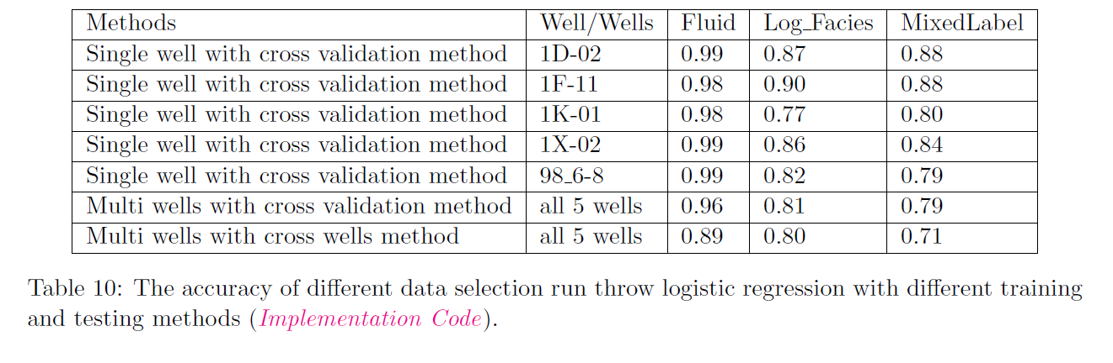
1. Supervised learning Approach and evaluation
(2) Training and Testing
Runzhi Zhou
Notes:
However, the high accuracy of cross validation methods may due to the fact that IP have trained data from the same well.
In reality, we always need to predict a whole new well. So the cross wells methods seems to be more robust.

Slide 23
1. Supervised learning
(3) Our Proposed Data Augmentation Method
How to increase the accuracy with limited data?
Runzhi Zhou

Slide 24
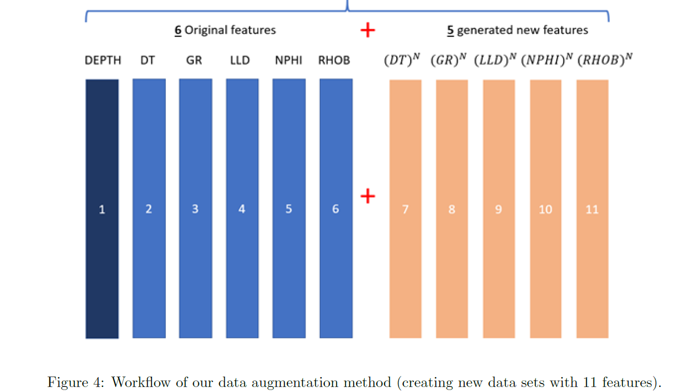
1. Supervised learning Approach and evaluation
(3) Our Proposed Data Augmentation Method
Total 11 Features
How to Choose the N(the power)?
Runzhi Zhou
Notes:
We have 6 original input features.
I create 5 new features each time by setting a power N for the original input features.
So there is total 11 input features.
I didn’t generate more features based on depth because the depth is uniformly distributed.
The problem is how to choose N, I then do testing for both Logistic regression and SVM methods.

Slide 25
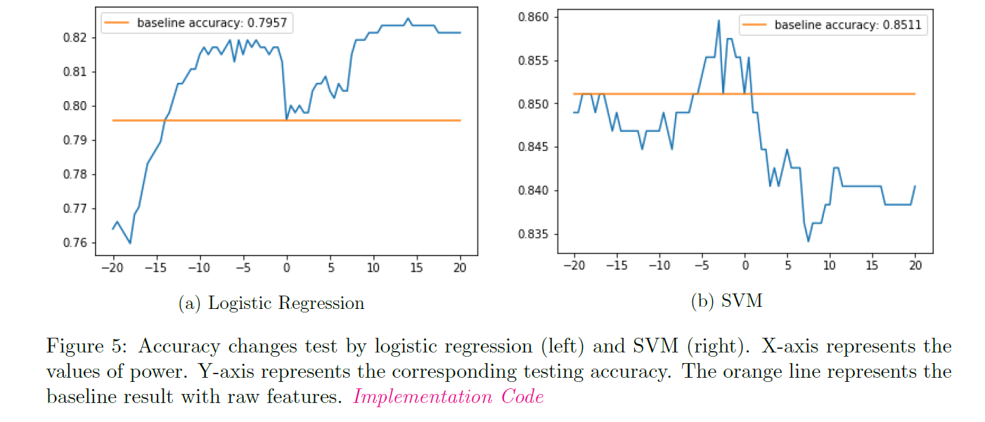
1. Supervised learning Approach and evaluation
(3) Our Proposed Data Augmentation Method
Runzhi Zhou
Notes:
For the logistic regression, most of the N is useful.
For the SVM, N is useful when it is between -5 to 2.
Both graphs show that my data augmentation method can increase the accuracy.

Slide 26
1. Supervised learning
(4) Setting Threshold Prediction Rate
How can we help companies with limited training data?
Runzhi Zhou

Slide 27
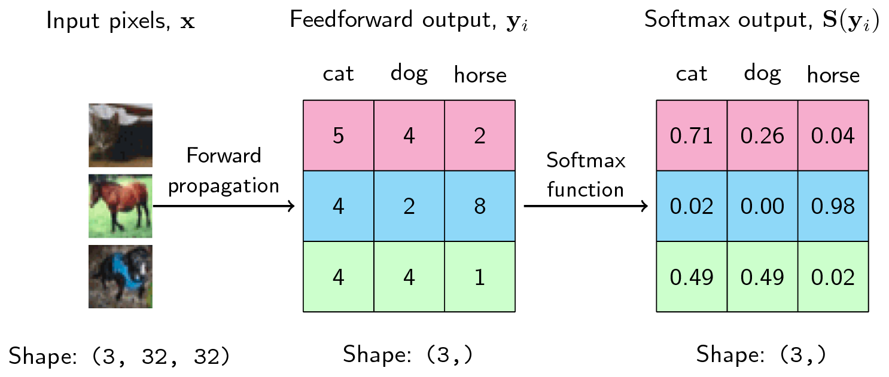
1. Supervised learning Approach and evaluation
(4) Setting Threshold Prediction Rate
Runzhi Zhou
Notes:
As we all know, SoftMax layer can print out the prediction rate for each class.
The SoftMax layer will choose the class with highest prediction rate.
But only the highest, this layer can give a prediction for one class with really low accuracy.
For example here: the green!49%. The model its not sure about it.
So if we set a threshold, for example 80%

Slide 28
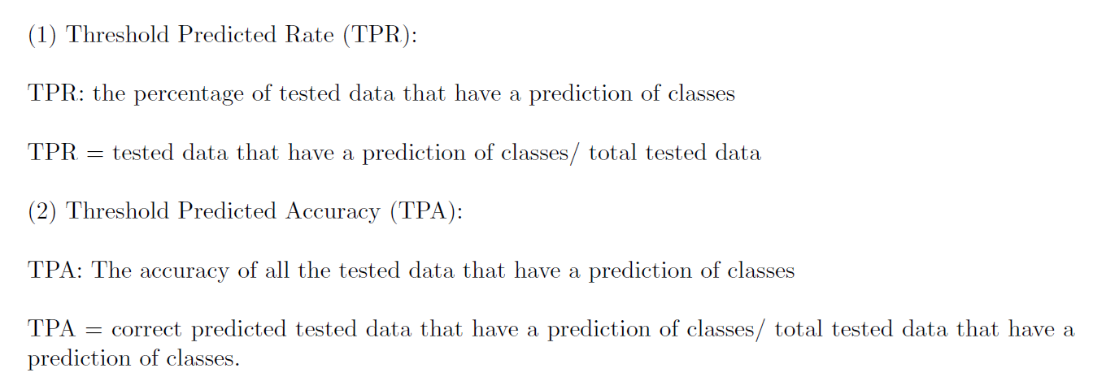
1. Supervised learning Approach and evaluation
(4) Setting Threshold Prediction Rate
Runzhi Zhou
Notes:
So, lets see the result.

Slide 29
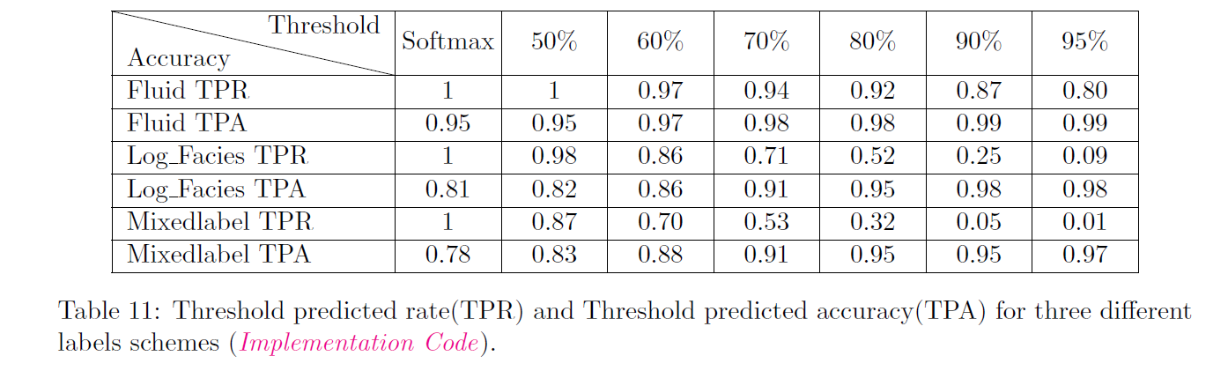
1. Supervised learning Approach and evaluation
(4) Setting Threshold Prediction Rate
Runzhi Zhou

Slide 30
2. Unsupervised Learning
Qualitative Evaluation by PCA and t-SNE
Quantitative Evaluation with K-means Clustering
Runzhi Zhou

Slide 31
2. Unsupervised Learning
(1) Qualitative Evaluation by PCA and t-SNE
Runzhi Zhou
Notes:
I draw 2D plots with PCA and t-SNE methods for observation.

Slide 32
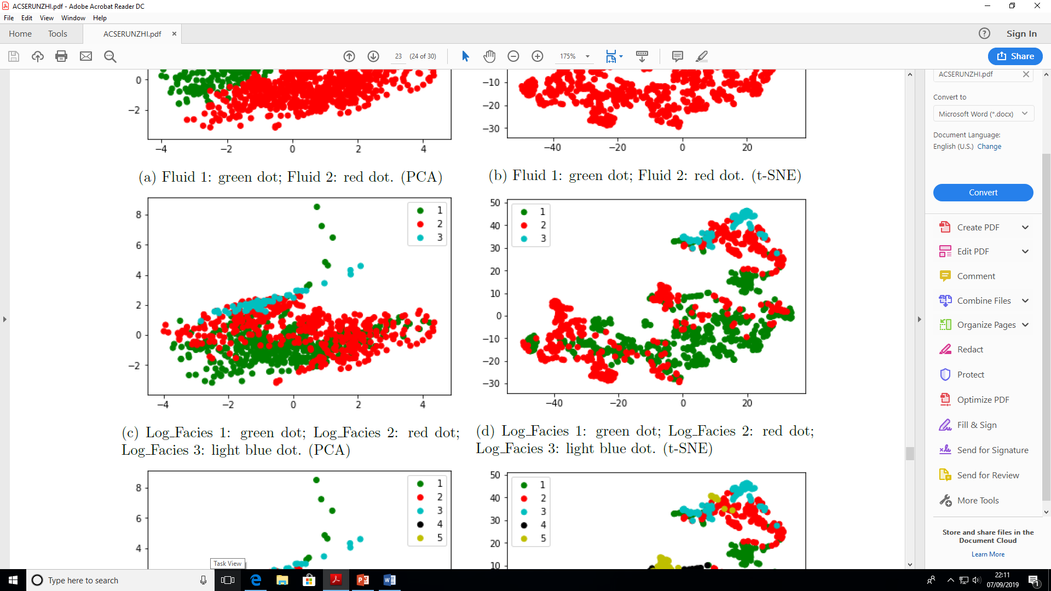
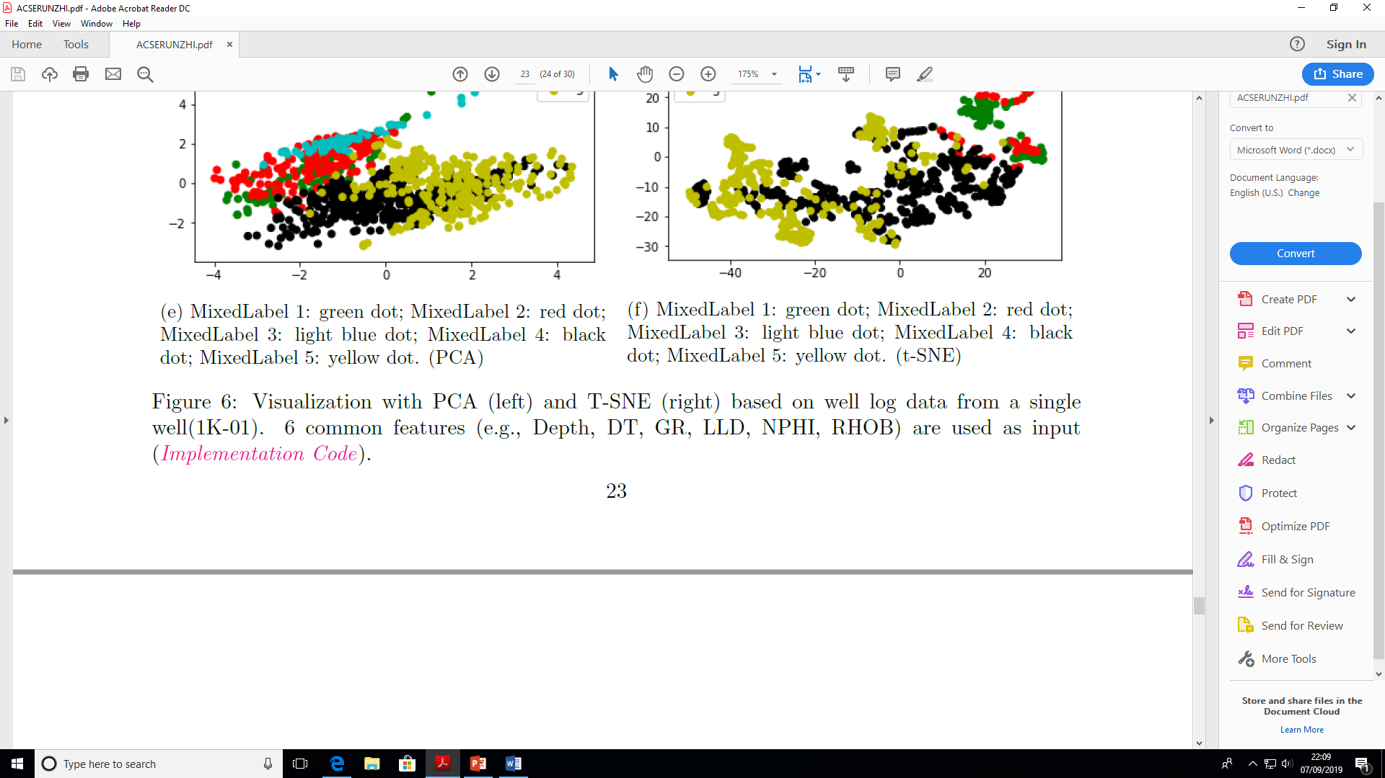
2. Unsupervised learning Approach and evaluation
(1) Qualitative Evaluation by PCA and t-SNE (Single well)
Log_Facies
No clear Clusters
Runzhi Zhou

Slide 33
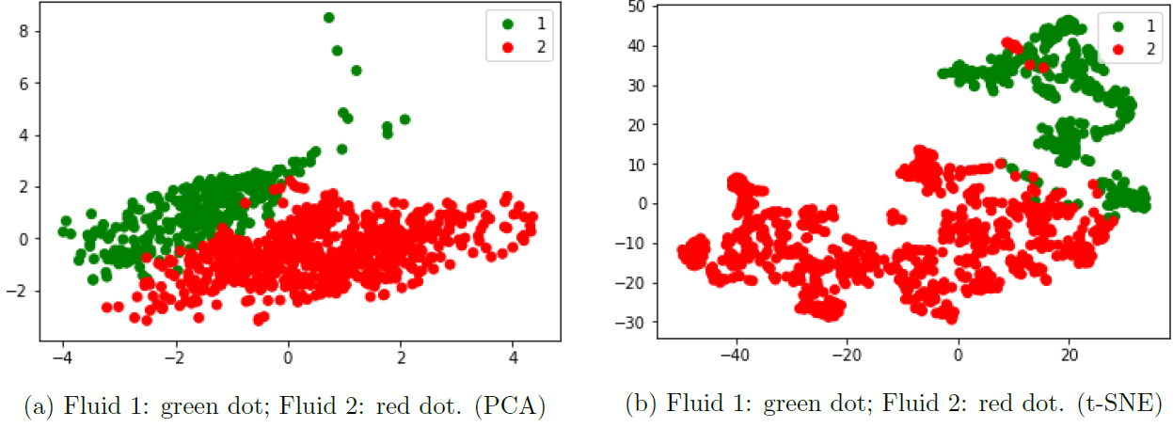
2. Unsupervised learning Approach and evaluation
(1) Qualitative Evaluation by PCA and t-SNE (Single well)
Fluid
Clear Clusters
Runzhi Zhou

Slide 34
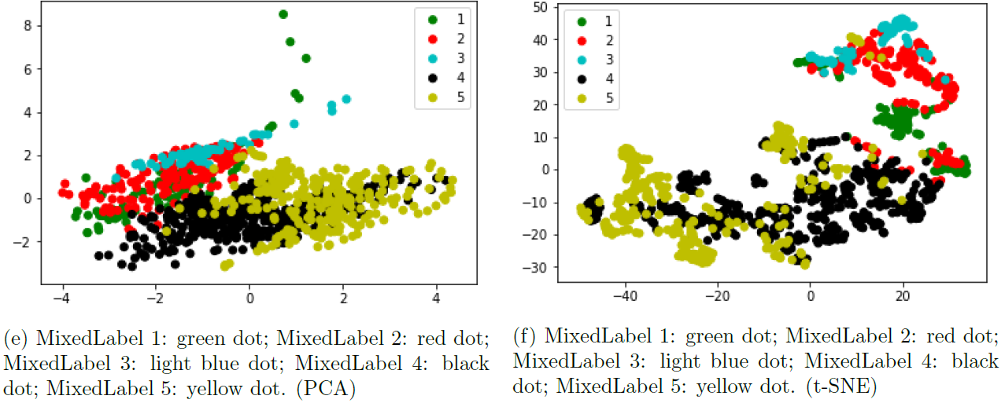
2. Unsupervised learning Approach and evaluation
(1) Qualitative Evaluation by PCA and t-SNE (Single well)
MixedLabel
No clear clusters
Runzhi Zhou

Slide 35
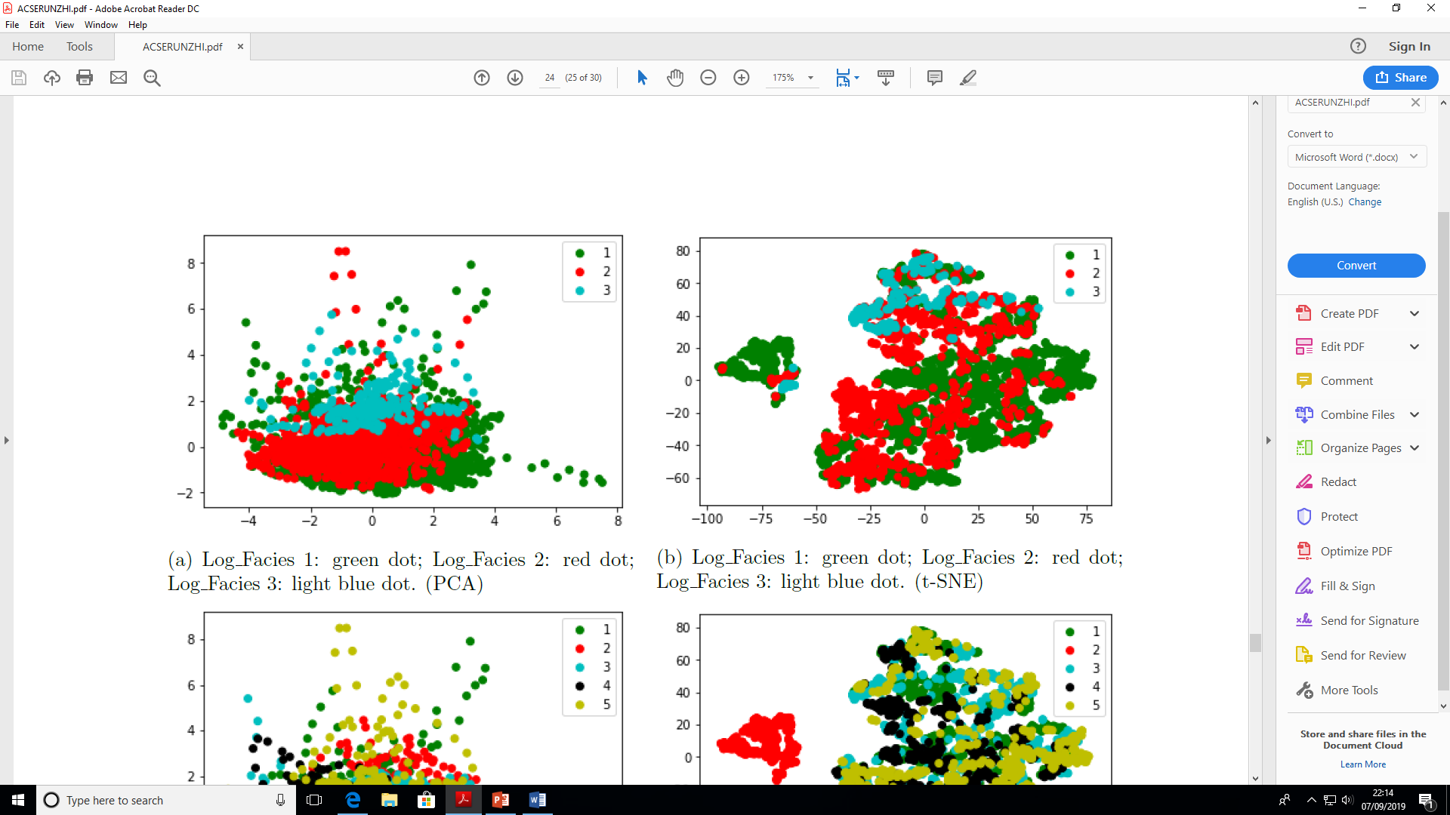
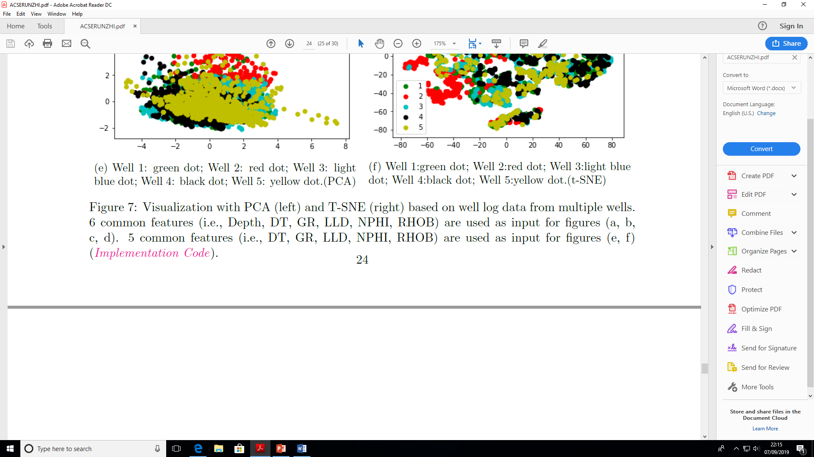
2. Unsupervised learning Approach and evaluation
(1) Qualitative Evaluation by PCA and t-SNE (Multi wells)
Log_Facies
Two clusters
Runzhi Zhou

Slide 36
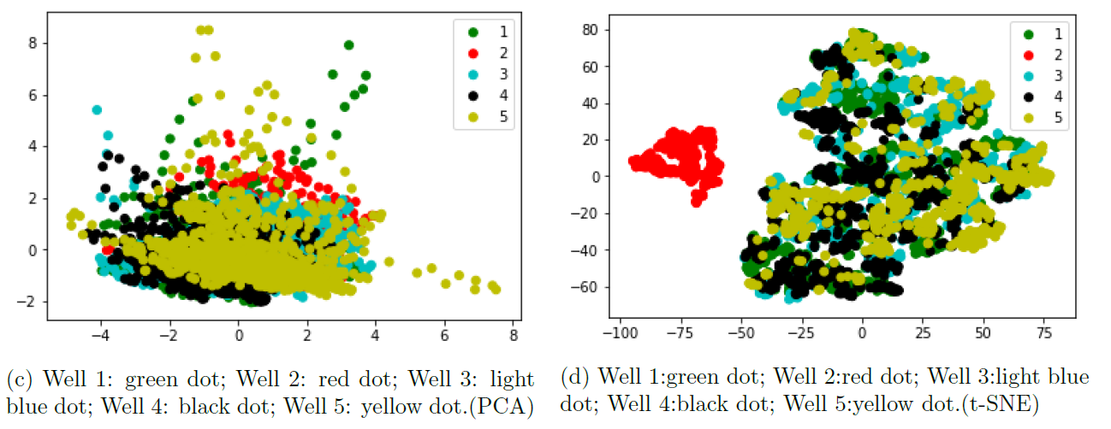
2. Unsupervised learning Approach and evaluation
(1) Qualitative Evaluation by PCA and t-SNE (Multi wells)
Wells
Separate one well
Runzhi Zhou

Slide 37
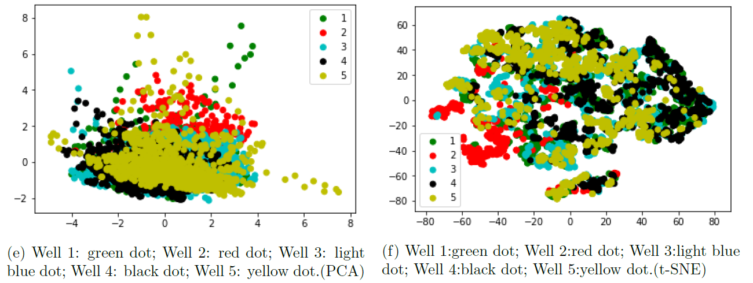
2. Unsupervised learning Approach and evaluation
(1) Qualitative Evaluation by PCA and t-SNE (Multi wells)
Wells
No clear clusters
Runzhi Zhou

Slide 38
2. Unsupervised Learning
(2) Quantitative Evaluation with K-means Clustering
Runzhi Zhou
Notes:
Firstly, we need to find a suitable K

Slide 39
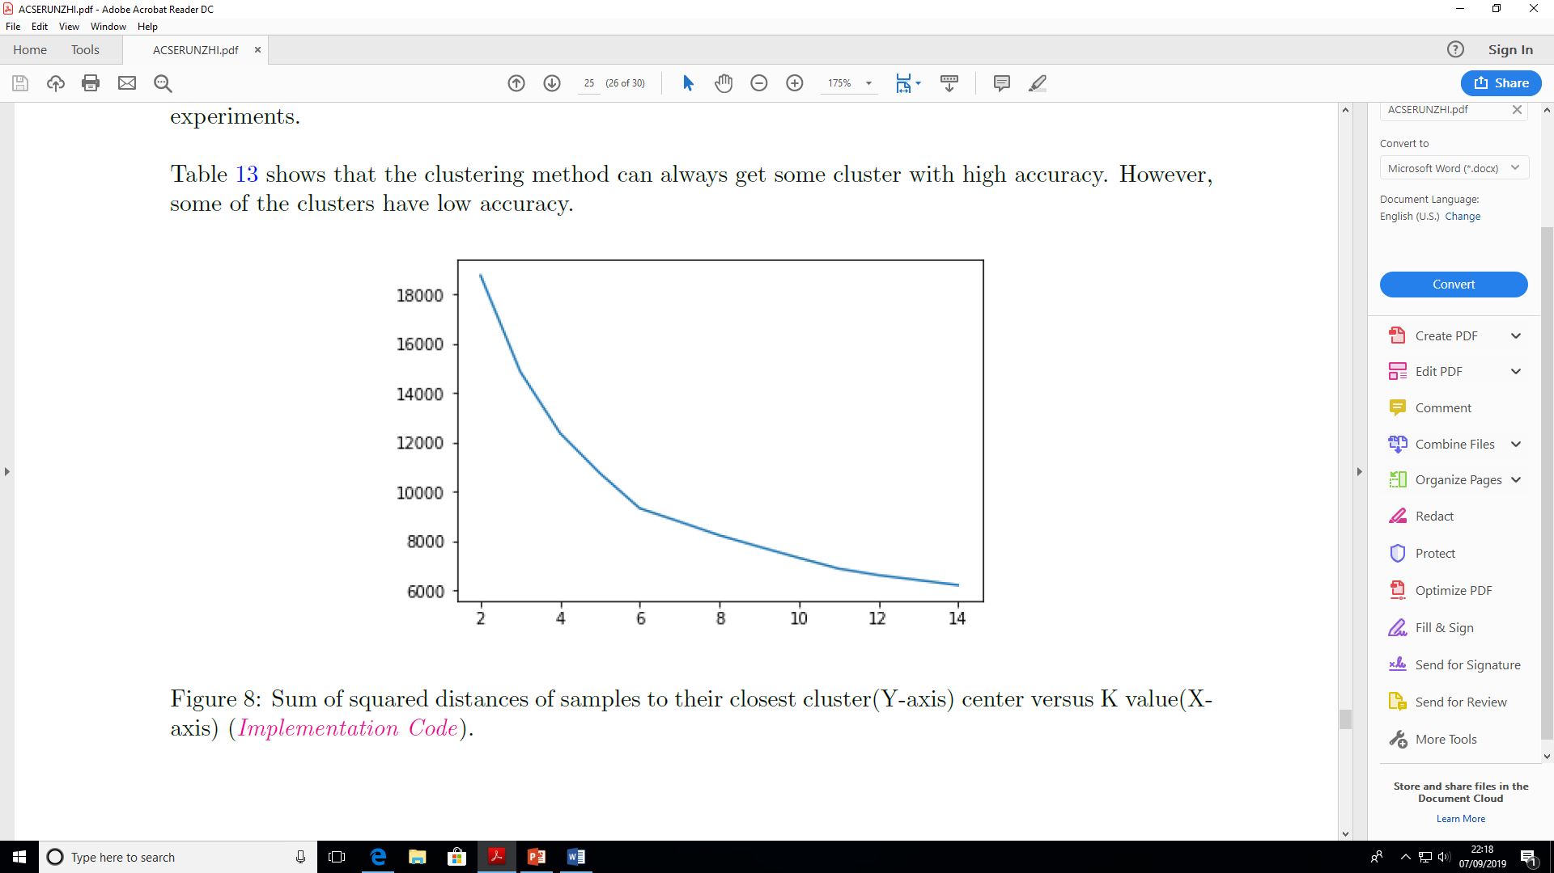
2. Unsupervised learning Approach and evaluation
(2) Quantitative Evaluation with K-means Clustering
The sum of squared distances
of samples to their closest cluster centre
decreases dramatically until
the number of clusters reaches to 6.
Elbow
Runzhi Zhou
Notes:
By using the elbow method, 6 should be a good choice for K, Because …

Slide 40
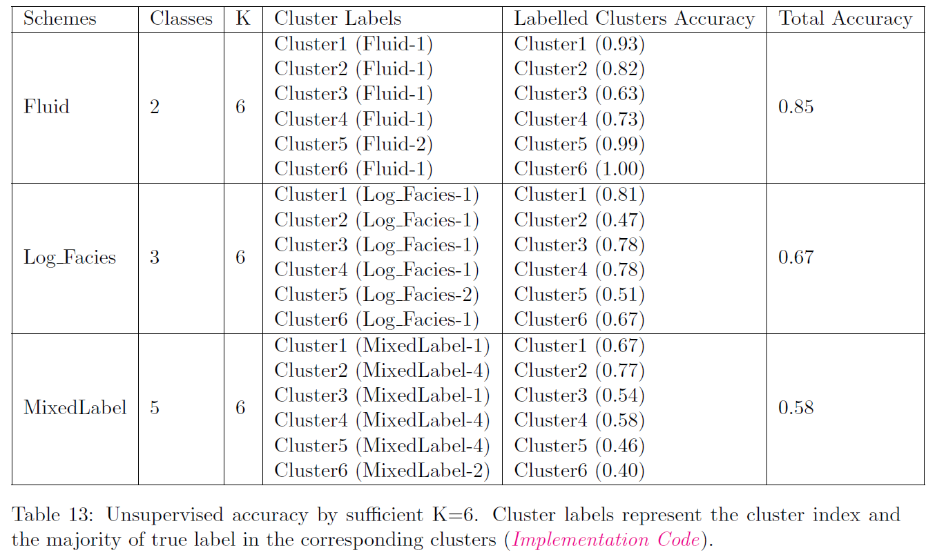
2. Unsupervised learning Approach and evaluation
(2) Quantitative Evaluation with K-means Clustering (K=6)
Runzhi Zhou

Slide 41
ACSE-9
Conclusion
(1) it is fundamental to keep all input features when developing a robust machine learning model;
(2) data splitting according to wells is more robust compared to directly random split the full data set;
(3) I proposed a MixedLabel approach for classification, which shows comparable performance.
Runzhi Zhou

Slide 42
ACSE-9
Conclusion
(4) I proposed a data augmentation approach by generating more input features with specific powers can improve classification performance remarkably;
(5) it is easy for both supervised and unsupervised methods to achieve higher prediction accuracies on a small portion of the training samples;
(6) supervised learning models are generally more robust and give higher accuracies than unsupervised learning models;
Runzhi Zhou

Slide 43
ACSE-9
Future Possible Implementations
All Input Features
Supervise learning
Data augmentation
Cross-wells
Runzhi Zhou

Slide 44
ACSE-9
10th, SEP, 2019
THANK YOU !
Runzhi Zhou

Slide 45
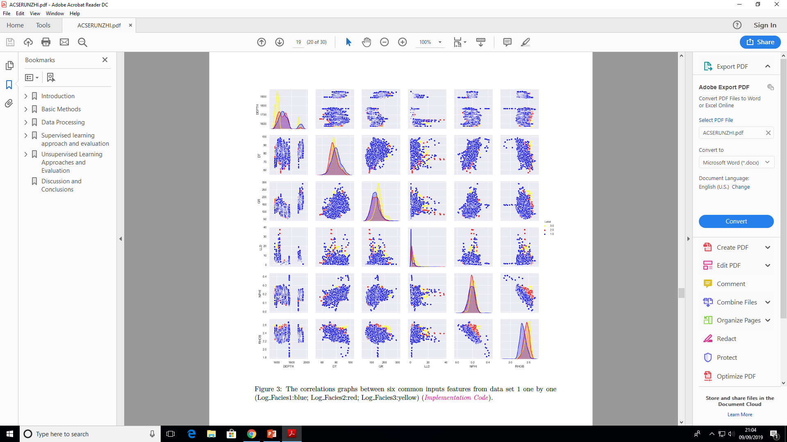
1. Supervised learning Approach and evaluation
(3) Our Proposed Data Augmentation Method
Runzhi Zhou

